Slide 1
Planovac
Presented by
Ravali Bolem (7)
Ashwini Gutha (33)
Pranathi Gopidi (29)
Satya Sai Deepthi Katta (41)

Slide 2
Problem Statement
PLANOVAC (means “Scheduler” in Czech language)
Students tend to forget their class timings, important assignment deadlines etc due to their hectic schedules.
This application works as a scheduler and reminds them of their important activities such as sending alerts when their classes start, alerts regarding submission deadlines etc.,

Slide 3
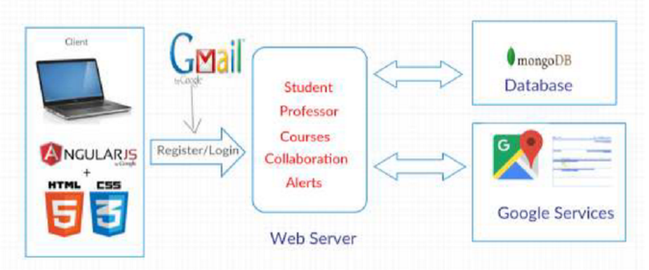
Software Architecture

Slide 4
Technologies
HTML 5
CSS
ANGULAR JS
MONGO DB
NODE JS

Slide 5
Features
Students can create an account in our application through registration page.
The user can also log into our application through Gmail log in.
This application provides a list of all the available classes. The user can choose all the classes he/ she is registered in.
The user gets an alert in the form of an email notification, 15 min before the class starts.

Slide 6
Features
Similarly, the user can also register his/ her other tasks such as assignment or project deadlines, and get alerts.
There is a chat room available for students to communicate with each other and also with the professor, through our application.
Students can also get the directions and weather details of their class rooms.

Slide 7
Thank You

